Slide 1
French Nouns/Adjectives Gender Prediction Experiments
14 April, 2025 (Monday)

Slide 2
Methodology Updates

Slide 3
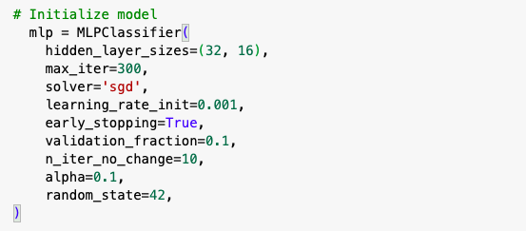
Methodology Update
MLP parameters were updated to handle overfitting

Slide 4
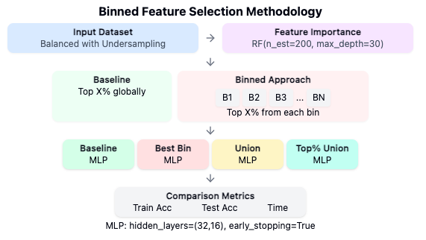
Methodology Update - Binning Approach Test

Slide 5
Nouns Gender Prediction
Experiment

Slide 6
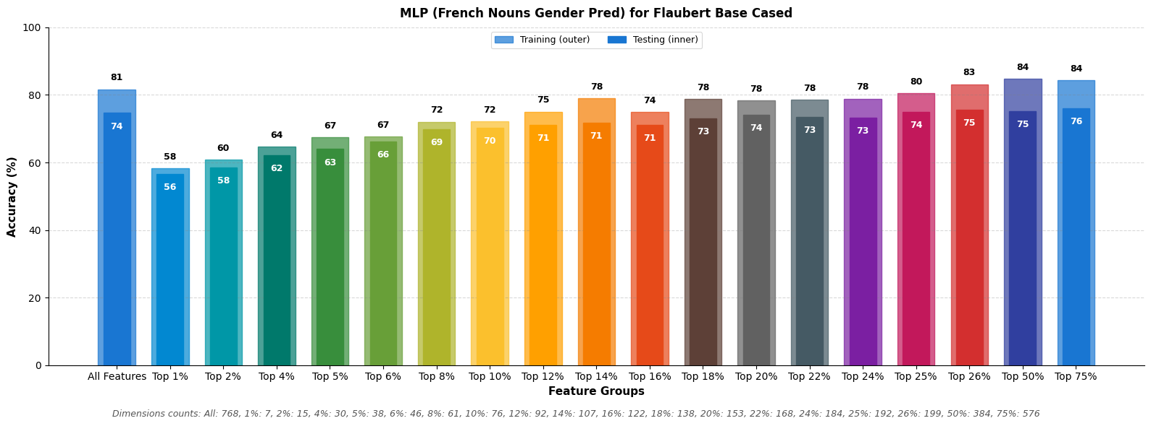
Nouns Gender Prediction - Flaubert Base Cased

Slide 7
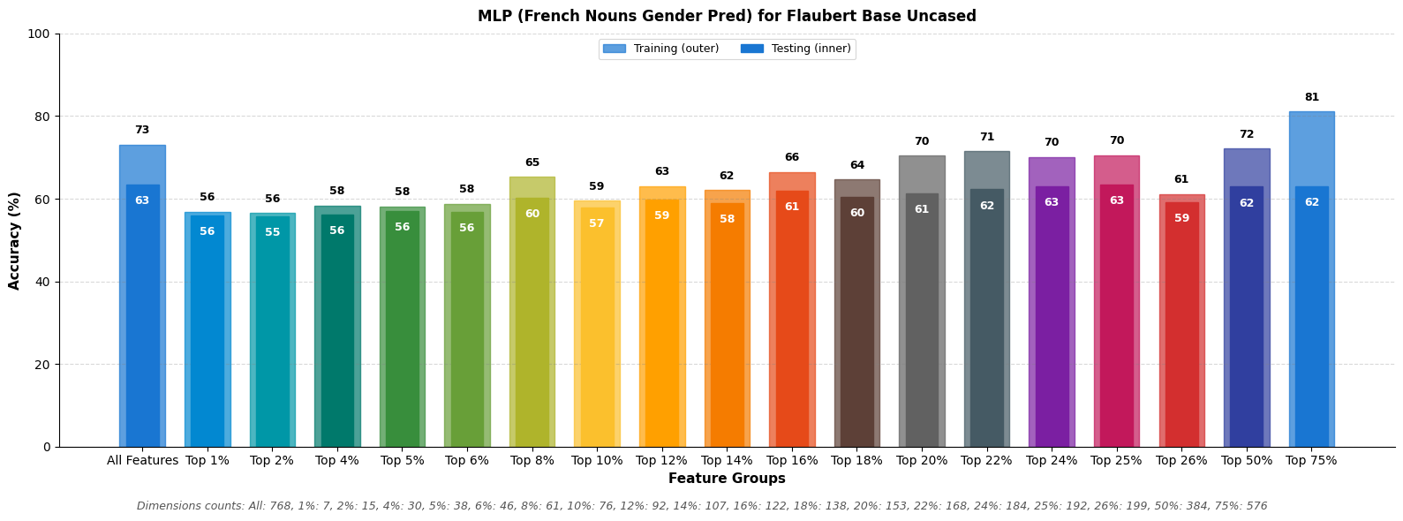
Nouns Gender Prediction - Flaubert Base Uncased

Slide 8
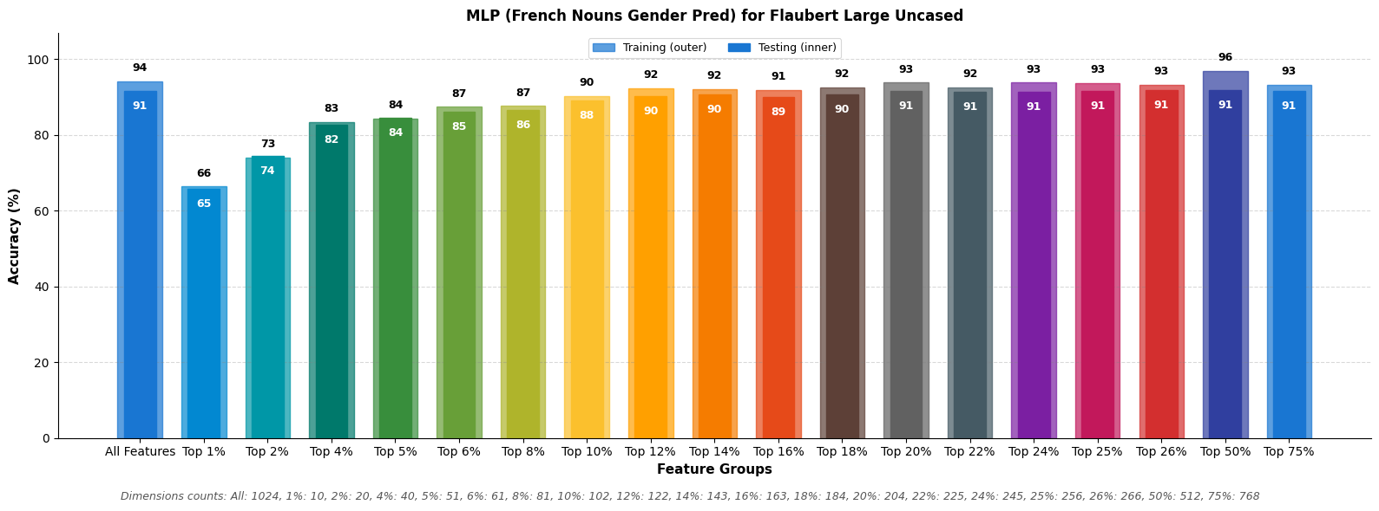
Nouns Gender Prediction - Flaubert Large

Slide 9
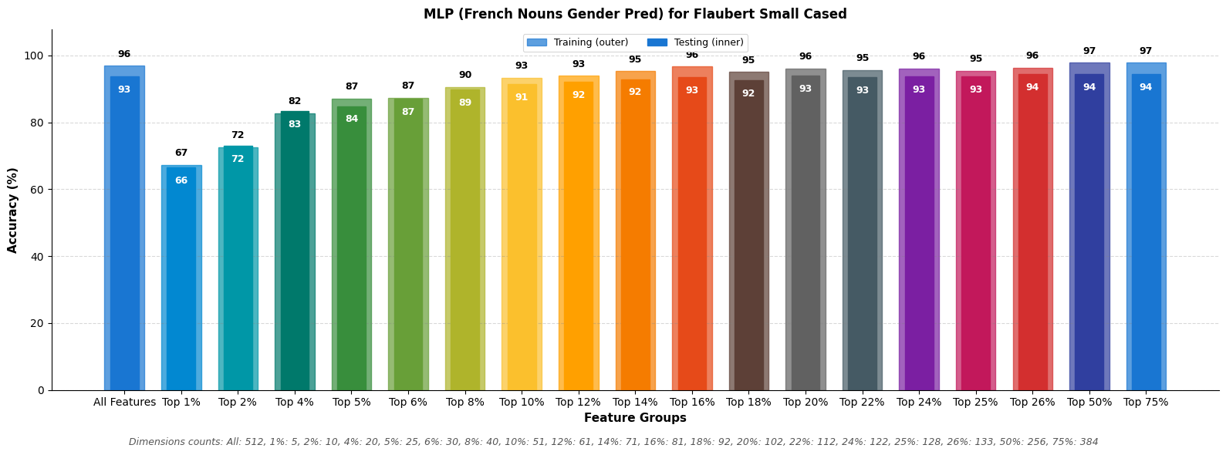
Nouns Gender Prediction - Flaubert Small Cased

Slide 10
Nouns Gender Prediction
Comparative Results

Slide 11
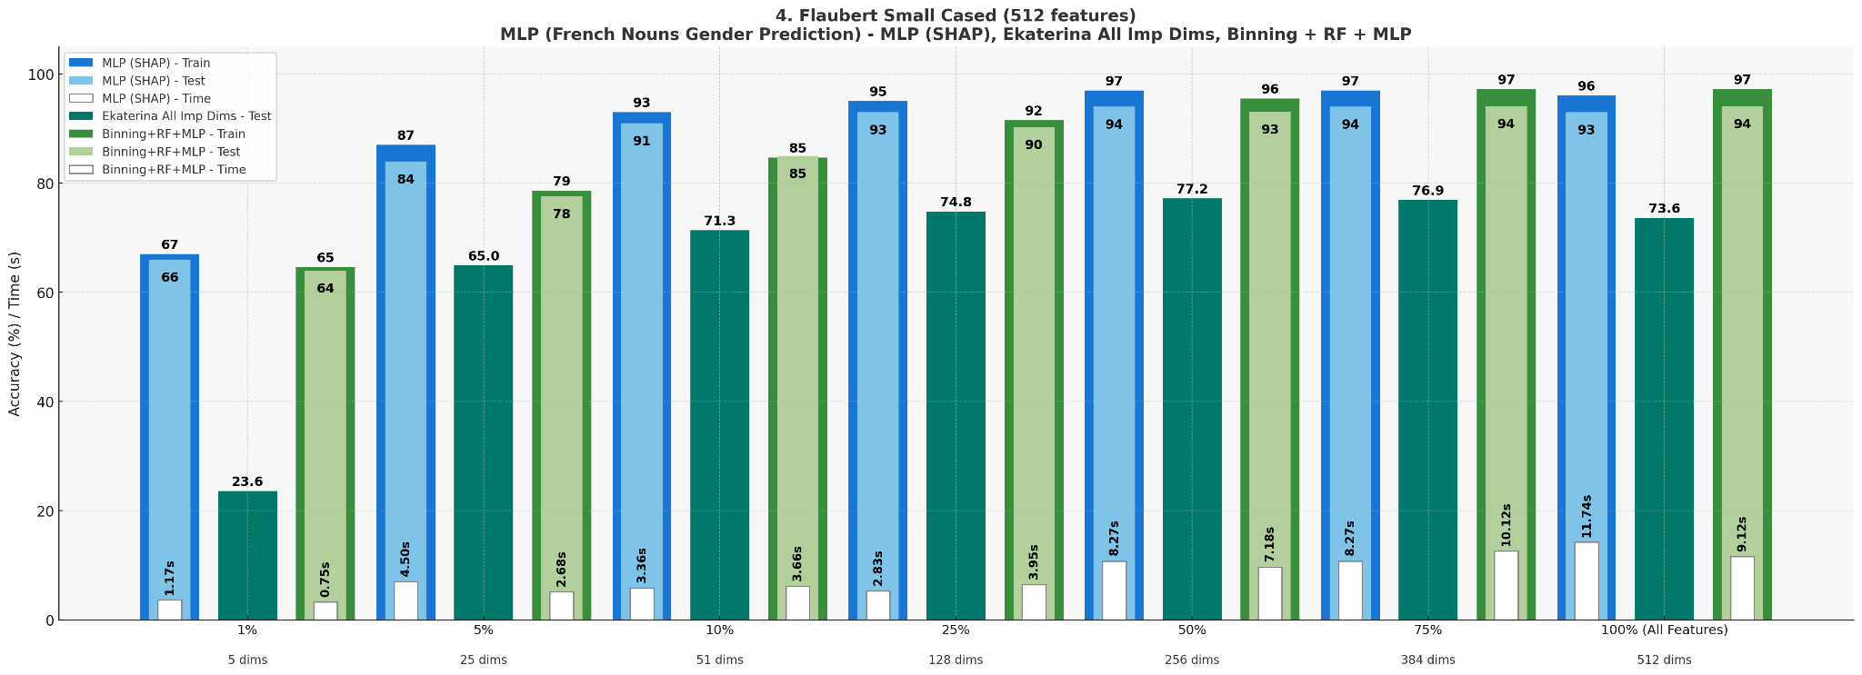
Nouns Gender Prediction - Flaubert Small Cased
MLP (Top SHAP N%) vs Ekaterina (All Imp Dims) vs Binning Approach (Bins + RF + MLP)

Slide 12
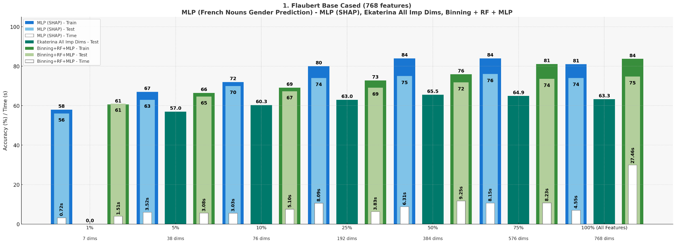
Nouns Gender Prediction - Flaubert Base Cased
MLP (Top SHAP N%) vs Ekaterina (All Imp Dims) vs Binning Approach (Bins + RF + MLP)

Slide 13
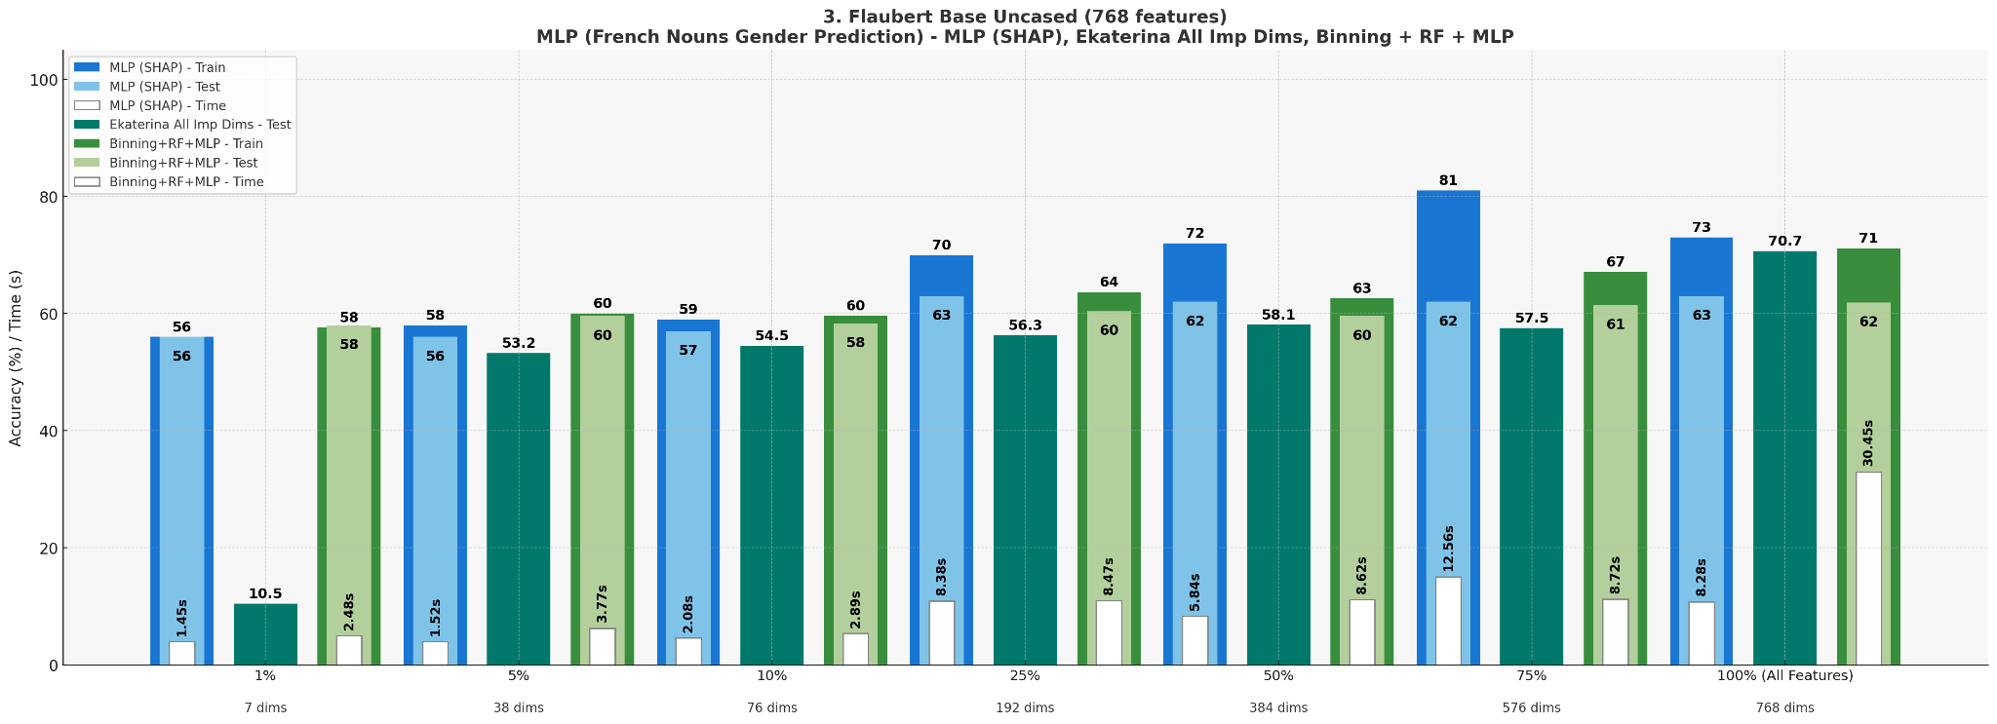
Nouns Gender Prediction - Flaubert Base Uncased
MLP (Top SHAP N%) vs Ekaterina (All Imp Dims) vs Binning Approach (Bins + RF + MLP)

Slide 14
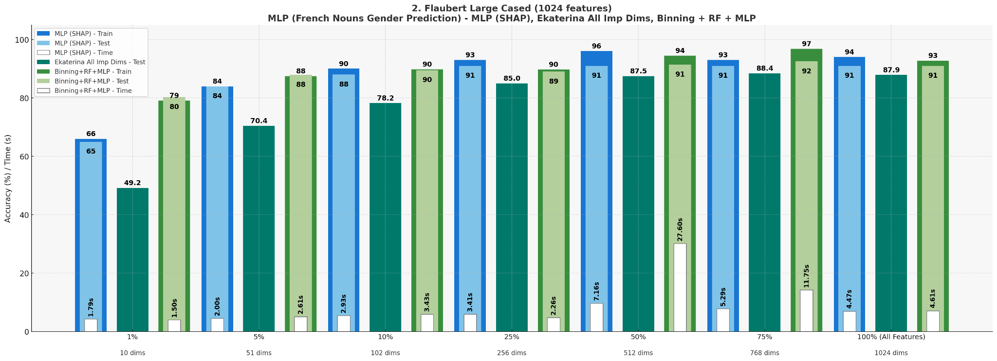
Nouns Gender Prediction - Flaubert Large
MLP (Top SHAP N%) vs Ekaterina (All Imp Dims) vs Binning Approach (Bins + RF + MLP)

Slide 15
Nouns Dimensions Overlapping

Slide 16
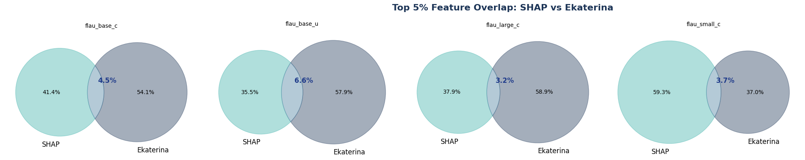
Top 5% - Overlapping
MLP (Top SHAP N%) vs Ekaterina (All Imp Dims)

Slide 17
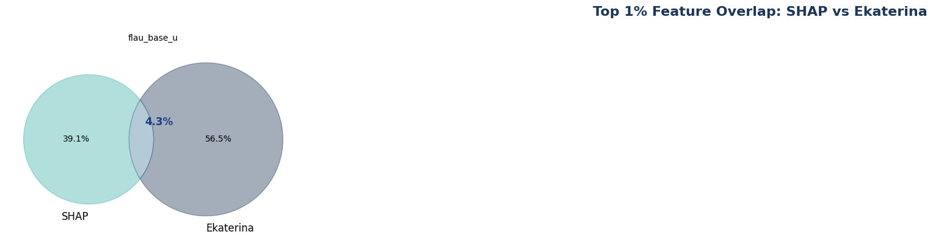
Top 1% - Overlapping
MLP (Top SHAP N%) vs Ekaterina (All Imp Dims)

Slide 18
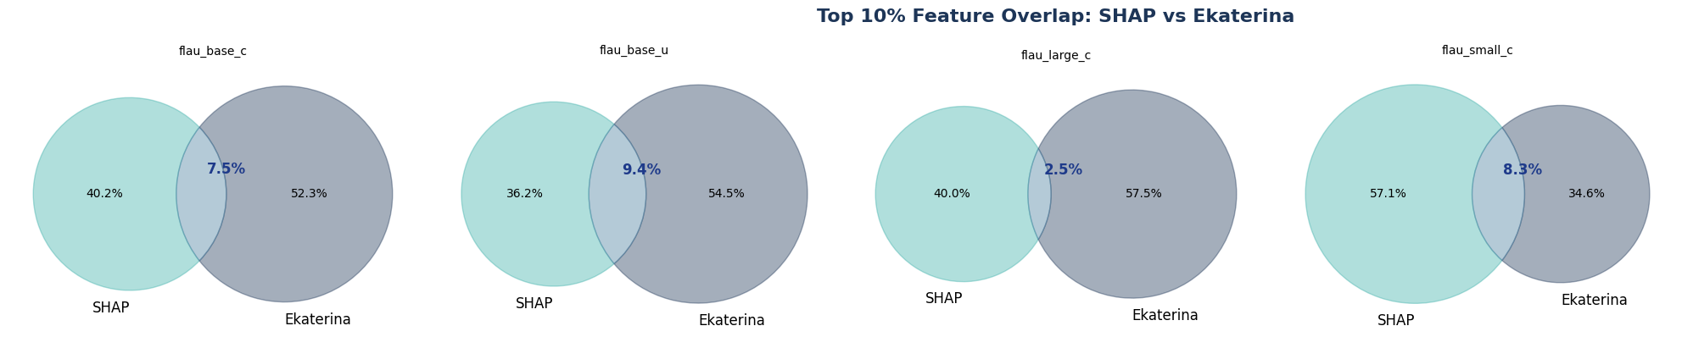
Top 10% - Overlapping
MLP (Top SHAP N%) vs Ekaterina (All Imp Dims)

Slide 19
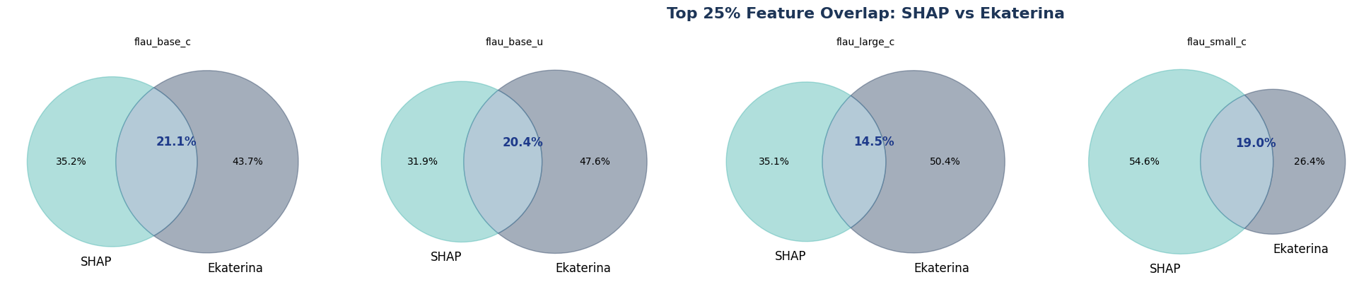
Top 25% - Overlapping
MLP (Top SHAP N%) vs Ekaterina (All Imp Dims)

Slide 20
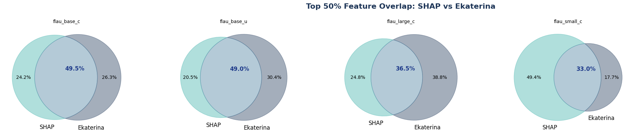
Top 50% - Overlapping
MLP (Top SHAP N%) vs Ekaterina (All Imp Dims)

Slide 21
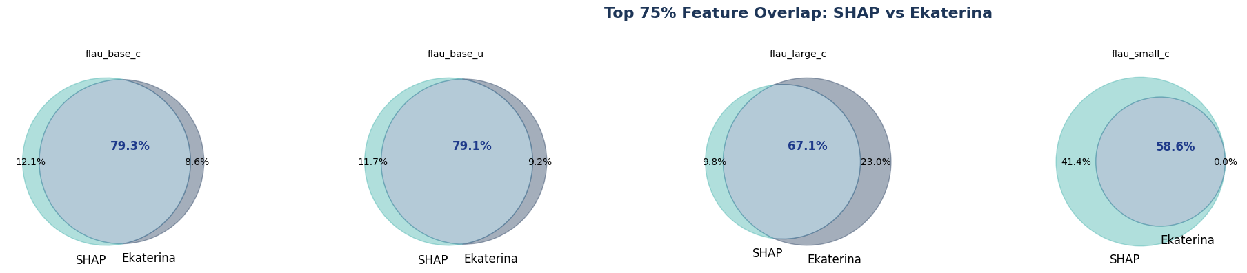
Top 75% - Overlapping
MLP (Top SHAP N%) vs Ekaterina (All Imp Dims)

Slide 22
Adjectives Gender Prediction
Experiment

Slide 23
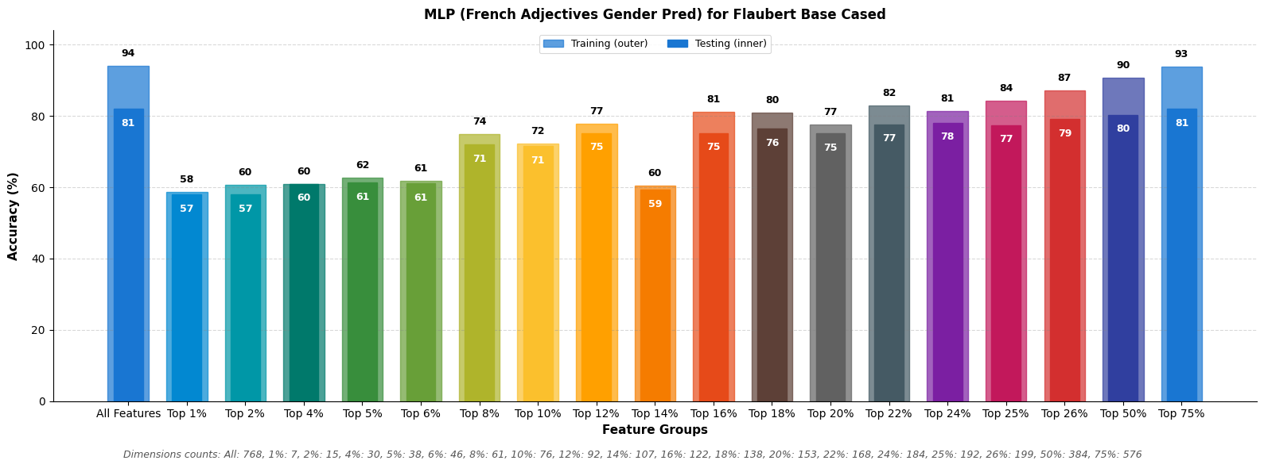
Adjectives Gender Prediction - Flaubert Base Cased

Slide 24
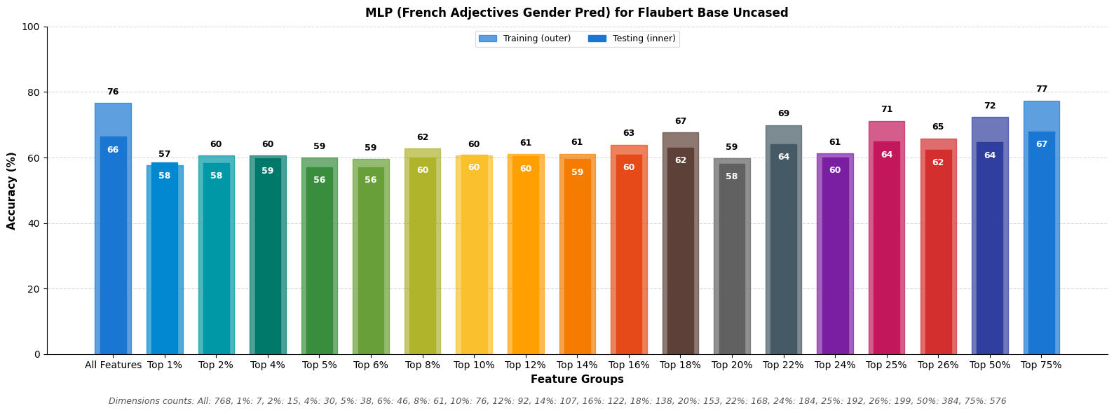
Adjectives Gender Prediction - Flaubert Base Uncased

Slide 25
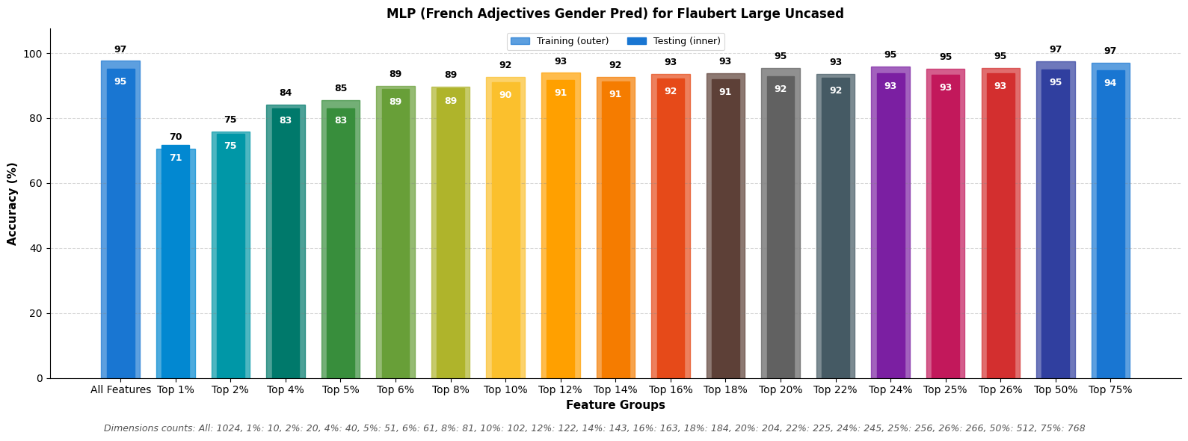
Adjectives Gender Prediction - Flaubert Large

Slide 26
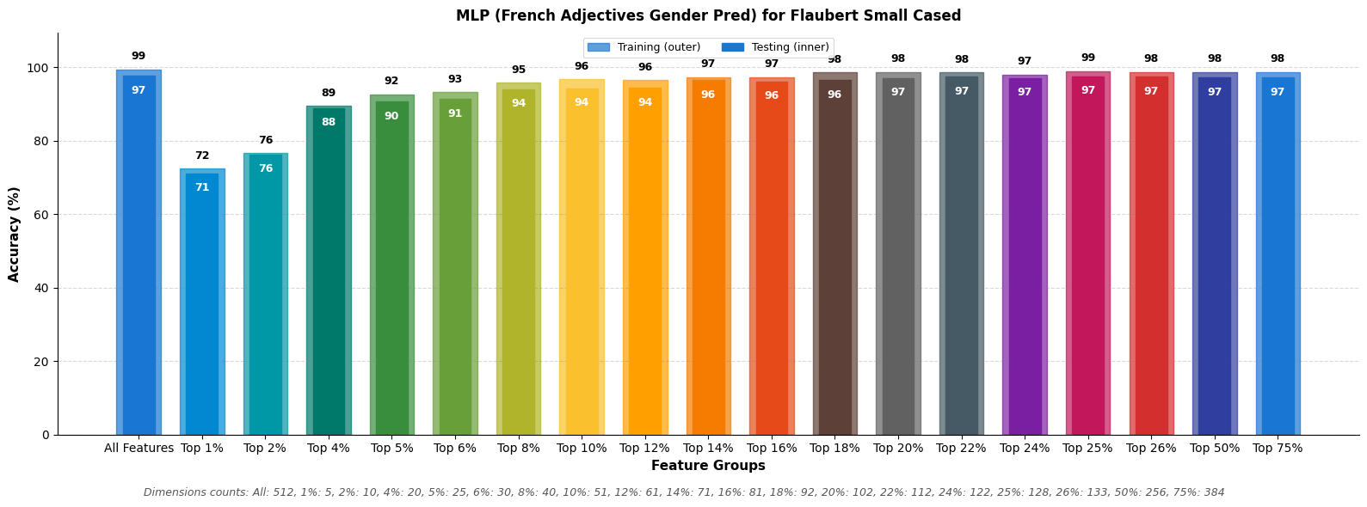
Adjectives Gender Prediction - Flaubert Small Cased

Slide 27
Adjectives Gender Prediction
Comparative Results

Slide 28
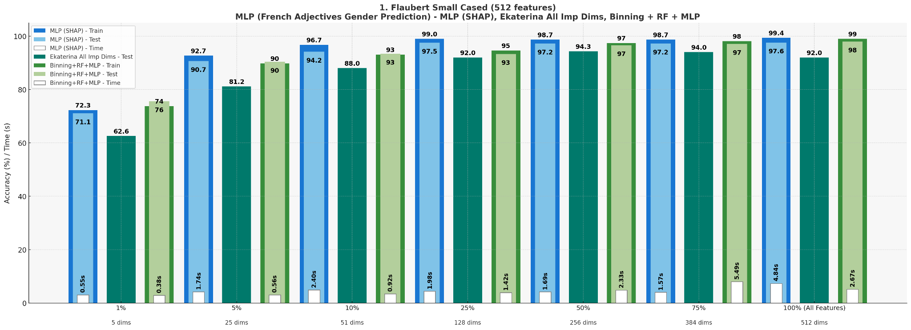
Adjectives Gender Prediction - Flaubert Small Cased
MLP (Top SHAP N%) vs Ekaterina (All Imp Dims) vs Binning Approach (Bins + RF + MLP)

Slide 29
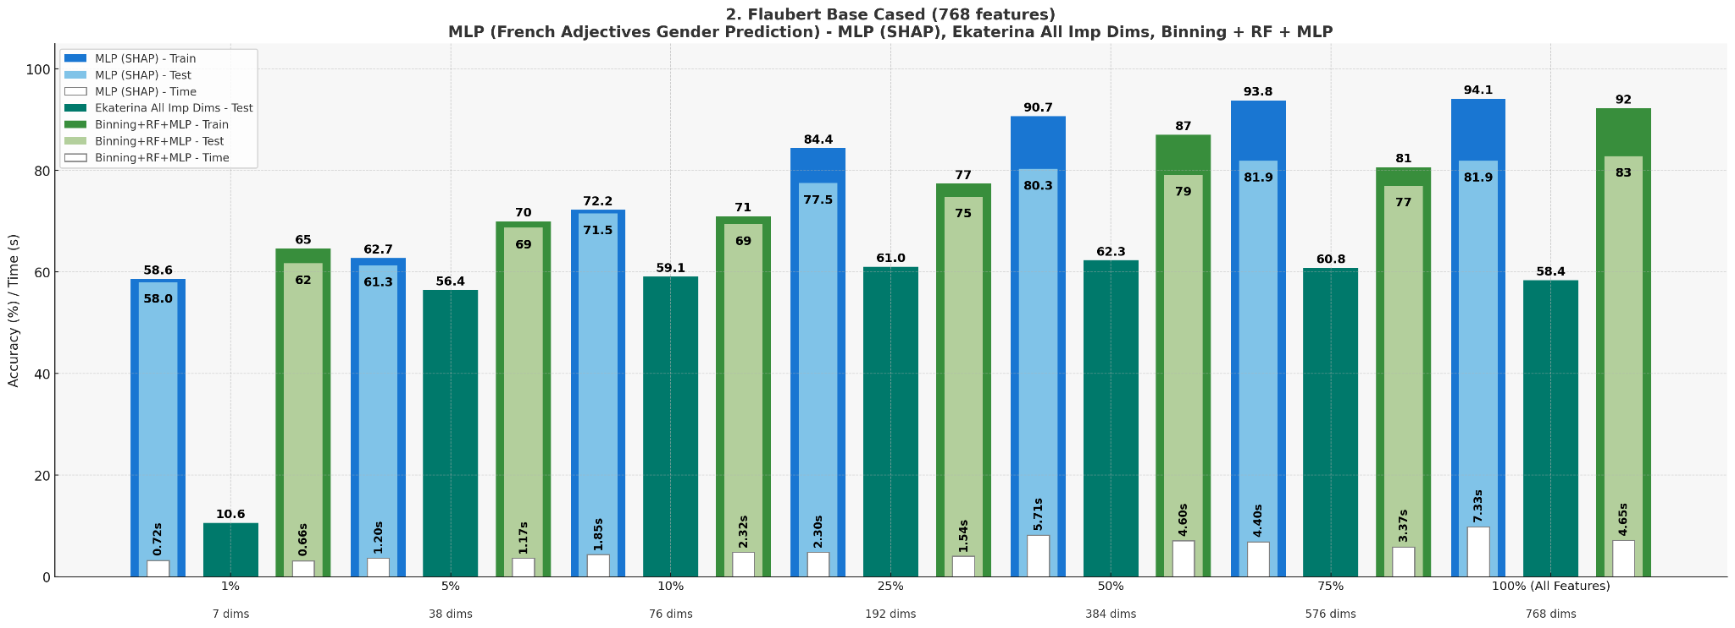
Adjectives Gender Prediction - Flaubert Base Cased
MLP (Top SHAP N%) vs Ekaterina (All Imp Dims) vs Binning Approach (Bins + RF + MLP)

Slide 30
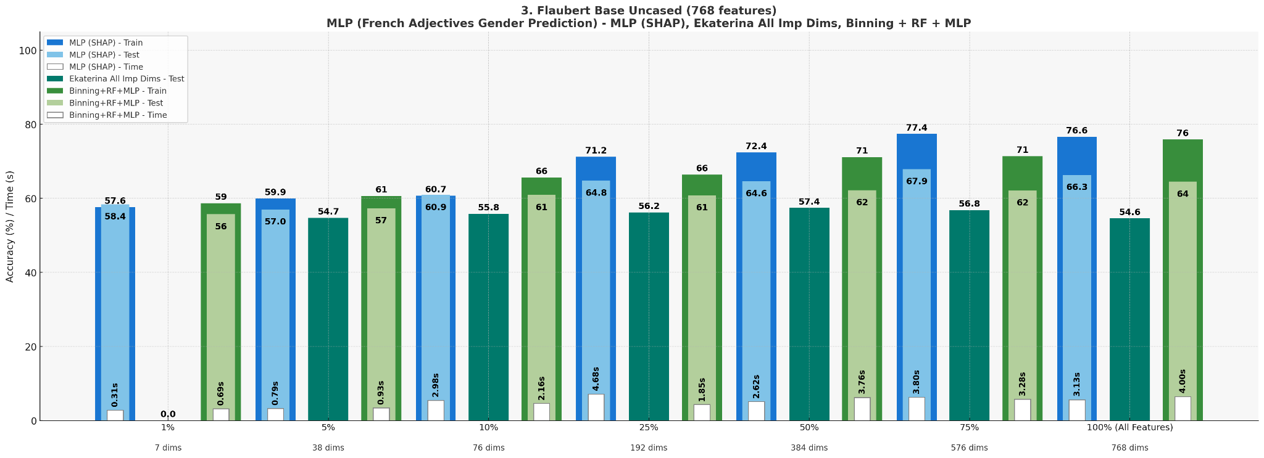
Adjectives Gender Prediction - Flaubert Base Uncased
MLP (Top SHAP N%) vs Ekaterina (All Imp Dims) vs Binning Approach (Bins + RF + MLP)

Slide 31
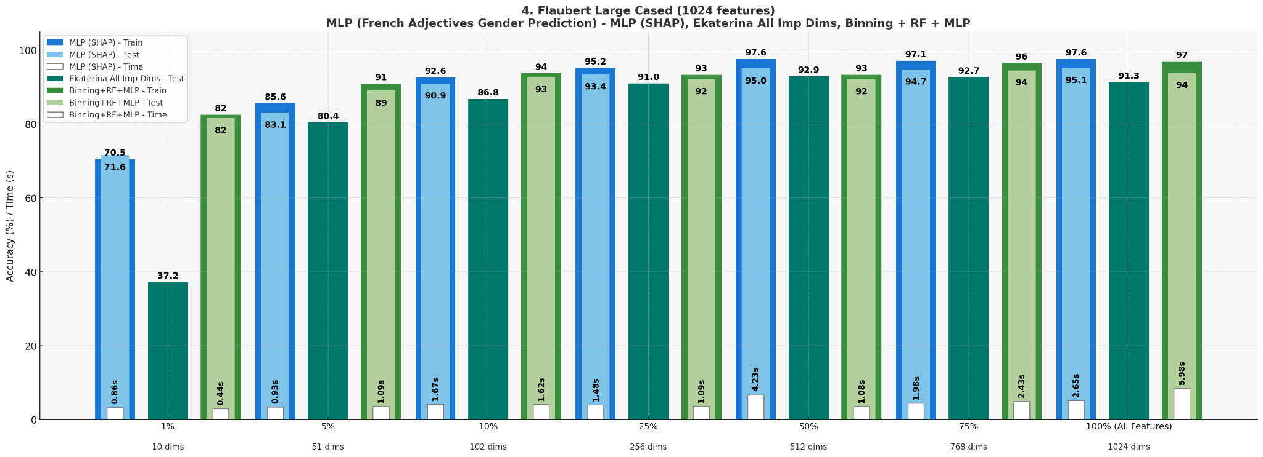
Adjectives Gender Prediction - Flaubert Large
MLP (Top SHAP N%) vs Ekaterina (All Imp Dims) vs Binning Approach (Bins + RF + MLP)

